Slide 1
README
BURN AFTER READING
about_SlideDeck
The actual presentation starts with slide 6 ("Session title"). The first five slides have a purely organisational purpose. During the break before your session, you should start the presentation with slide 2 ("Next up"), so that the audience knows that they are in the right room. It's fine if you start chatting with the audience during this break, but we need a precise starting point for your presentation in terms of editing your video. That means:
The recording of your presentation will start after the countdown. Please (RE)START talking after the countdown, not during it! Otherwise your recording will start with a half sentence.
It is not necessary to explicitly signal to the PA operator, this is your signal!
Finally, do you have to use this slide deck? No, you are free to present the way you like it. But you are asked to use the intro slides: countdown, session title, sponsor slide. Beyond that, use what is good for the cause – from no slides to sketches from your children, from Jupyter to $youNameIt.
You will find additional information in the notes below.
Sincerely, your hosts!
Dear Speaker, we are thrilled and honored to have you with us in Antwerp in 2024. Take your time and read this before you prepare your session.
Since most of you have been with us before, you will already know a lot about PSConfEU. You know that we try to capture all sessions carefully and publish your work on YouTube. There are a few easily avoidable stumbling blocks that we would like to draw your attention to:
Your screen resolution should be 1920x1080 px (FullHD)
You should provide a full size HDMI socket
Mirror your screen
Disable "Presenter View" in PowerPoint
Using MAC or Surface book? Be aware of HDCP!
Notes:
The fine print (additional information)
Why should you care about HDCP?
"High-bandwidth Digital Content Protection (HDCP) is a form of digital copy protection developed by Intel Corporation to prevent copying of digital audio and video content as it travels across connections. Types of connections include DisplayPort (DP), Digital Visual Interface (DVI), and High-Definition Multimedia Interface (HDMI), as well as less popular or now deprecated protocols like Gigabit Video Interface (GVIF) and Unified Display Interface (UDI)."
https://en.wikipedia.org/wiki/High-bandwidth_Digital_Content_Protection
Some notebooks ignore the HDCP standard, some vendors comply with the standard. Apple and Microsoft are somehow famous for strictly following the HDCP guidelines. Sadly, we will not be able to guarantee, that your session can be recorded in the latter case.
But you can do simple things, to overcome these problems. It is also very likely that you presented with your notebook before. So you will know, if this worked fine.If you are in doubt and if the agenda allows, try a dry-run a day before and connect everything.
In general you can easily bypass HDCP restrictions with a cheap splitter (the cheaper the better), just like the one you see below. This is an example device that we bought for 16 euros (in Germany).
Ask us, we will lend you such a device.
Thorsten also gave a whole presentation about "Broadcasting yourself" - easy steps to record yourself and create a (backup) session recording on your own. If you want to invest your time and dive deeper, take a look at his recordings and notes:
https://vimeo.com/thorstenbutz/byourself
This is of course completely voluntary, but perhaps you will find it helpful.

Slide 2
Next Up:
Christian Ritter

Slide 3
3
3

Slide 4
2

Slide 5
1

Slide 6
Create a custom Microsoft Graph connector with PowerShell
Christian Ritter

Slide 7

Many thanks to our sponsors:

Slide 8

Created with designer.microsoft.com

Slide 9
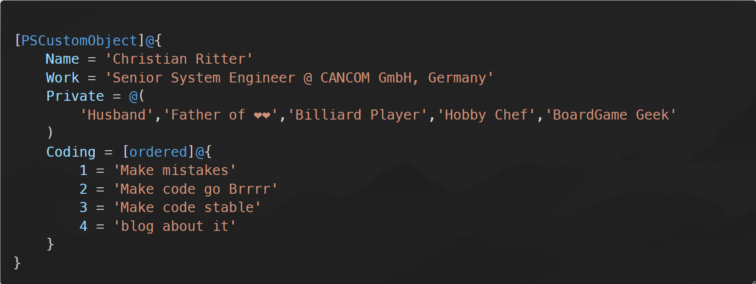

>_ (GET-Speaker).FullDetails

Slide 10
Disclaimer: Or get things straightened first
If I am the smartest person in this room; I am in the wrong room.
Have questions or additions? Shout! (if the answer takes too much room, we will shift it to the end the session)

Slide 11
What are Graph Connectors: The Spirits of Data Integration
Microsoft Graph connectors integrate external content into Microsoft Graph.
Discover external data through:
Microsoft Search
Context IQ (Outlook web)
Microsoft 365 Copilot
Microsoft 365 app

Slide 12

Created with designer.microsoft.com

Slide 13
The Endpoint Brewery: Crafting Custom Graph Connectors
Create an App-Registration
Define the Schema for your data to ingest
Define the layout for your Adaptive Cards

Slide 14
Demos
We love Demos!

Slide 15

Created with designer.microsoft.com

Slide 16
Graph a Pint: Pouring Content into Microsoft Graph
Collect external data (eq. PSConfEu Session-Data)
Transform it to fit into the Schema of the Custom Connector
Ingest your data

Slide 17
Demos
We love Demos!

Slide 18

Created with designer.microsoft.com

Slide 19
Know your LIMITS: The Fine Art of API usage
Limit type | Limit
Connection Resources per Microsoft 365 Tenant | 30
Items per Connection | 5,000,000
Connection byte size | 500 GB
Items per tenant | 50,000,000
Information Source: Microsoft Learn

Slide 20
Last call: Shoutouts
Paul Bullock:
Code base from the Ignite 2023
Ben Reader:
No Passwords, No Problem: Secure Azure Authentication with MSAL & PowerShell
14:00 Today!

Slide 21
Q&A
15 minutes

